Slide 1
Investigating Mathematical Reasoning Capabilities of LLMs
Aayush Ranjan 2021003
Arnav Agarwal 2021235
Parthiv A Dholaria 2021078
Harshvardhan Singh 2021052
Pulkit Nargotra 2021273
Utsav Garg 2021108

Slide 2
Problem Statement
Large Language Models (LLMs) excel in understanding and generating text but often struggle with complex reasoning tasks, especially in mathematical and logical domains. This highlights the need for frameworks that enhance reasoning accuracy and adaptability across diverse challenges.

Slide 3
Contributions
Innovative Framework: Introduced RAG+Multi-Agent approach integrating retrieval-augmented generation with specialized collaborative agents.
Comprehensive Evaluation: Rigorous comparison of reasoning paradigms, including zero-shot, CoT, ReAct, and RAG+Multi-Agent frameworks.
Robust Findings: Identified critical gaps in handling irrelevant details and proposed advancements for meta-reasoning.
Future-Oriented Solutions: Paved the way for scalable reasoning strategies combining modular reasoning and retrieval mechanisms.
Performance Insights: Highlighted trade-offs in accuracy across models like LLaMA -70B/8B, Gemma-9B, and Mistral-8x7B.

Slide 4
Dataset
SVAMP Dataset
Focuses on single-variable arithmetic problems requiring multi-step reasoning.
Tests the model’s ability to parse and solve simple arithmetic questions in natural language.
Example:John had 3 apples. He bought 5 more. How many apples does he have? Answer: 8.
GSM8K Dataset
Contains 8,000 high-quality math word problems covering arithmetic, algebra, geometry, and logic.
Emphasizes advanced multi-step reasoning and numerical accuracy.
Example:James writes a 3-page letter to 2 different friends twice a week. How many pages does he write a year? Answer:3*2*2=12*52=624.
We use the metric accuracy over all baselines and frameworks.

Slide 5
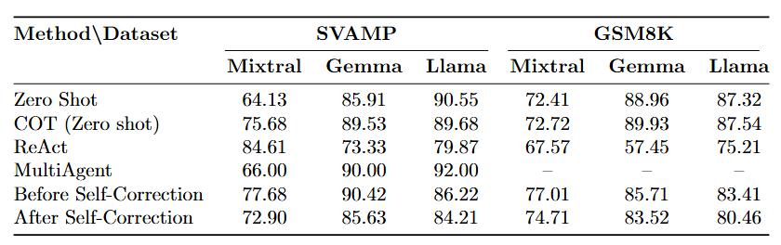
Baselines

Slide 6
Baselines: Prompting Strategies
1. Zero-Shot Prompting
Definition: Solves math problems directly using pre-trained capabilities without intermediate reasoning.
Key Insight: Gemma and Llama outperform Mixtral, highlighting strong baseline reasoning abilities.
2. Chain-of-Thought (CoT) Prompting
Definition: Encourages step-by-step intermediate reasoning to enhance multi-step problem-solving.
Key Insight: Improves performance over Zero-Shot; Gemma slightly surpasses Llama on GSM8K.
3. ReAct Prompting
Definition: Combines reasoning and action with tools (e.g., calculators) to refine solutions dynamically.
Key Insight: Mixtral performs best on SVAMP but struggles on GSM8K due to its multi-step complexity.

Slide 7
Baselines: Self Correction
Core Principle: Self-correction involves a multi-round prompting framework where LLMs iteratively refine their responses to identify and correct errors across three distinct rounds.
Process:
Round 1: Model generates an initial response to a math problem.
Round 2: Model reviews its answer to identify errors.
Round 3: Model improves its response and provides a final corrected answer, verified for accuracy.
Key Insight: On SVAMP and GSM8k, self-correction slightly reduced accuracy across Mixtral, Gemma, and LLAMA, suggesting issues with overcorrection.
Takeaway: Self-correction enhances iterative reasoning but requires optimization to prevent unnecessary revisions.

Slide 8
Baselines: Multi-Agent
Core Principle:
A collaborative framework where the Student LLM generates solutions and the Teacher LLM evaluates and refines them through iterative feedback.
Roles:
Student: Solves problems, provides explanations, and generates answers in a fixed template.
Teacher: Evaluates responses, identifies errors, and offers corrective feedback.
Key Insight:
Achieved 92.00% on SVAMP with LLAMA, highlighting the effectiveness of collaborative reasoning. GSM8k experiments were limited due to resource constraints.

Slide 9
RAG on AQUA
RAG Integration: Combines Retrieval-Augmented Generation with LLMs by providing suitable context.
Pinecone Utilization: Leverages Pinecone to store and retrieve embeddings from a 1,000-sample AQUA-RAT subset.
Contextual Prompting: Retrieves top-3 relevant question-answer pairs to create enriched prompts for better LLM responses.
LLM Models Used: Processes enriched prompts with models like Meta-Llama 3.1-8B-Instruct , Gemma 9B , and Mixtral-8x-7b, ensuring standardized output.
Dataset Evaluation: Tested on GSM8K and SVAMP datasets (100 samples), achieving improved accuracy with manual evaluation.

Slide 10
Fine Tuning: QLoRA
QLoRA fine-tunes large models efficiently by quantizing weights and updating low-rank matrices, enabling task-specific adaptation with minimal resources.
Experimental Setup
Epochs: 4,
Target Modules: 'q_proj', 'k_proj', 'v_proj', 'dense'
Results
Fine-tuning with QLoRA led to a significant drop in performance across tasks on SVAMP and GSM8k datasets.
These adaptations may cause the model to lose previously learned generalization capabilities, a phenomenon known as catastrophic forgetting, especially when the fine-tuning task is too narrowly focused.
QLoRA relies on low-precision quantization (e.g., 4-bit/8-bit), which can result in a loss of precision for critical model weights.
Learning Rate: 5*10^-4
Rank (r): 32

Slide 11
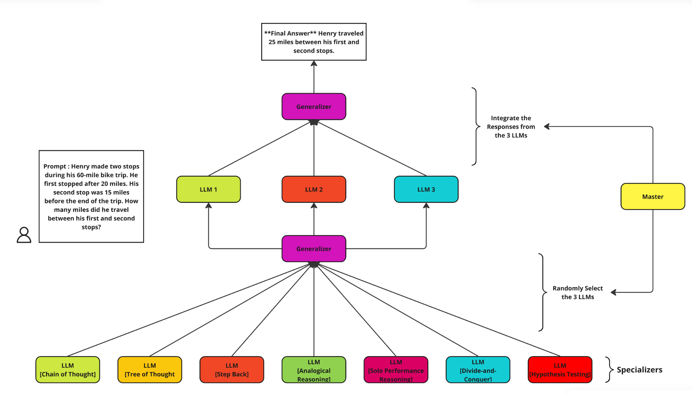
Multi Agent : Architecture

Slide 12
Multi Agent
Meta-Reasoning Inspiration: Adapts Meta-Reasoning Prompting to dynamically combine specialized reasoning methods for accuracy and flexibility.
Specialized Agents: Implements seven reasoning styles (Chain of Thought, Tree of Thought, solo performance, Stepback etc), each solving problems independently.
Generalizer Role: Synthesizes outputs from selected agents into a unified, coherent solution.
Master Agent: Coordinates agent selection (Random 3), collects responses, and ensures collaborative problem-solving.
The collection output is then compared to the ground truth answer for each of the 100 test samples and accuracy is reported for all the 4 models.

Slide 13
Multi Agent
Technique | Definition
Chain of Thought (CoT) | Step-by-step reasoning, breaking down problems into smaller logical steps.
Tree of Thought (ToT) | Explores multiple solution paths to identify the best approach.
Analogical Reasoning | Solves problems by drawing parallels to similar, well-known problems.
Divide-and-Conquer | Decomposes problems into smaller subproblems to solve independently and combine.
Hypothesis Testing | Formulates and tests multiple hypotheses to converge on the most viable solution.
Step-Back Reasoning | Generalizes problems and revisits prior steps for verification and error correction.
Solo Performance Reasoning | Simulates multi-persona collaboration to combine diverse perspectives for problem-solving.

Slide 14
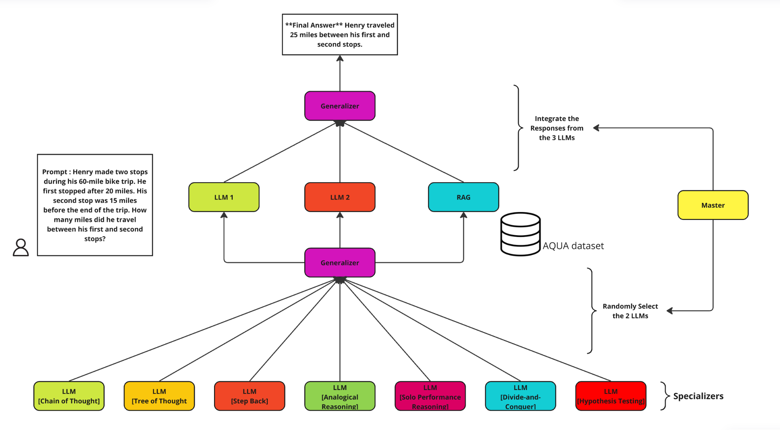
Multi Agent with RAG : Architecture

Slide 15
Multi Agent with RAG : Architecture
Meta-Reasoning Inspiration: Adapts Meta-Reasoning Prompting to dynamically combine specialized reasoning methods for accuracy and flexibility.
Specialized Agents: Implements seven reasoning styles (e.g., Chain of Thought, Tree of Thought, solo performance, Stepback etc), each solving problems independently.
Generalizer Role: Synthesizes outputs from selected agents into a unified, coherent solution.
RAG Specalizer: An additional RAG specializer using pinecone. (Dataset : AQUA_RAT,1000 samples).
Master Agent: Coordinates agent selection (Random 2) + RAG, collects responses, and ensures collaborative problem-solving.

Slide 16
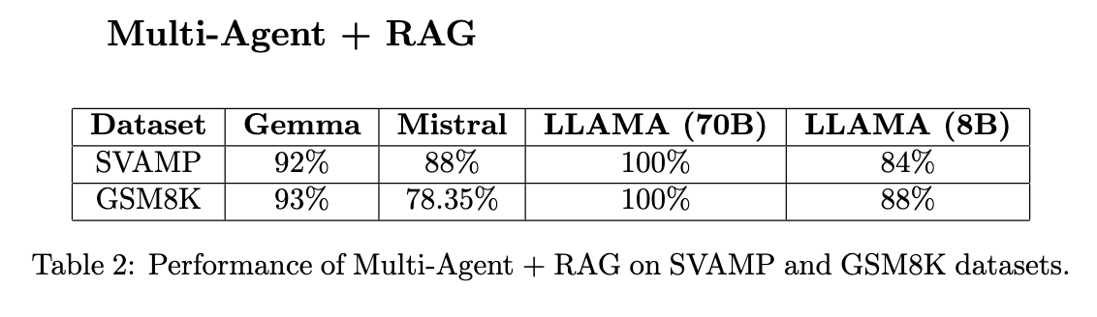
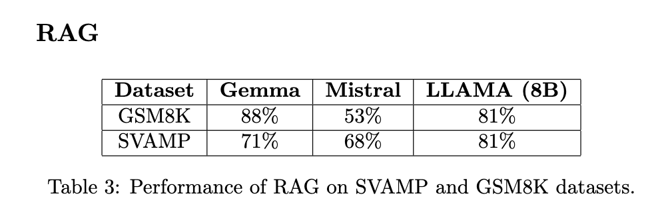
Results

Slide 17
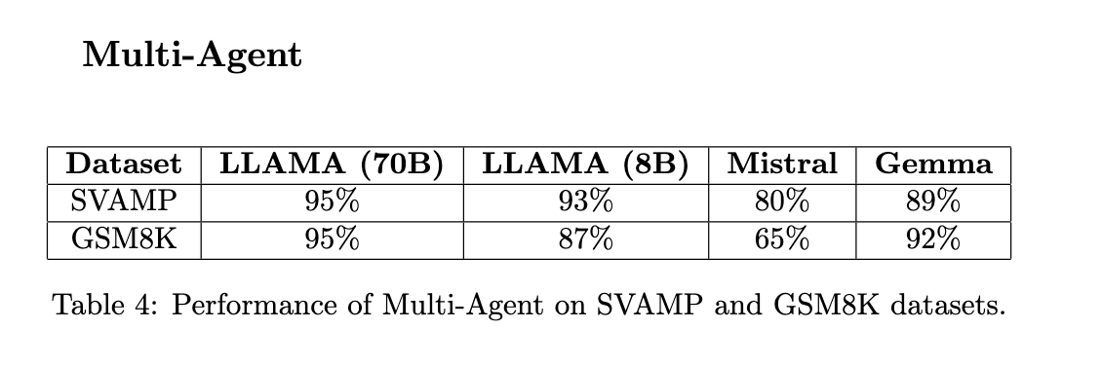
Results

Slide 18
Results

Slide 19
Analysis
Model Size Advantage: Larger models like LLAMA (70B) achieve the highest accuracy, with 100% in the Multi-Agent + RAG framework, showcasing the benefits of higher parameter counts for complex reasoning tasks.
Multi-Agent Framework Impact: Across all models, the Multi-Agent framework consistently improves accuracy, highlighting the effectiveness of collaborative reasoning strategies.
RAG Augmentation Strength: Combining RAG with Multi-Agent methods further enhances performance, especially for larger models like LLAMA (70B) and Gemma.
Dataset Complexity: GSM8K poses a greater challenge compared to SVAMP, particularly for smaller models like Mistral, which show a noticeable performance gap.
Consistency in Performance: The Gemma model exhibits reliable and strong performance across all setups, making it a versatile choice for reasoning tasks.

Slide 20
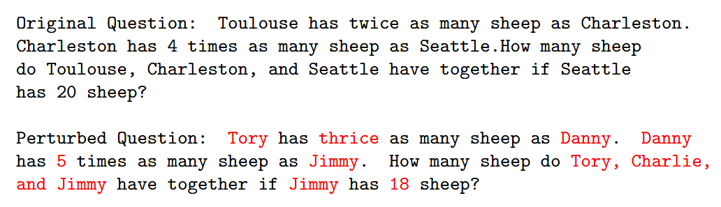
Discussion: Membership Inference
Objective: Assess if the model's high performance is due to overfitting or genuine reasoning.
Dataset: GSM8K.
Attack 1: Change proper nouns and numerical values.
Result: Model solved most problems correctly; showed generalization rather than memorization.

Slide 21
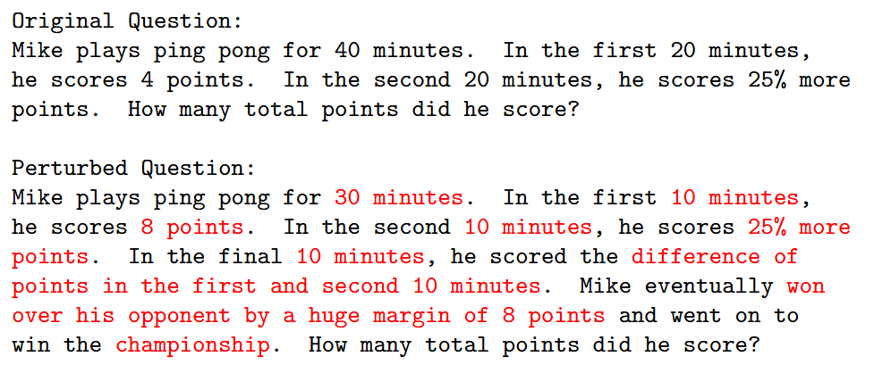
Discussion: Membership Inference
Attack 2: Introduce irrelevant details.
Result: Model often failed to filter out irrelevant information, leading to errors
Strengths: Model showed resilience to name and number changes, indicating real logical reasoning.
Weaknesses: Difficulty with irrelevant information suggests a lack of robust meta-reasoning capabilities.

Slide 22
Discussion: GSM-hard
Dataset: Harder version of GSM8K, constructed with larger, less common numbers.
LLaMA-3.1-70B Zero-Shot Accuracy: 48%
Improved Performance with Framework: Increased to 53%
Struggles with Large Numbers: Consistent issue with mathematical operations on very large and very small numbers.
Motivates augmentation with external tools like calculators for better performance.

Slide 23
Discussion: Larger Models
Model Used: Llama-3.1-70B-Instruct
Improved Logical Reasoning: Larger models exhibit superior logical reasoning compared to smaller models with significant accuracy gains on datasets.
Larger model generalizes better in complex, multi-step problems, showcasing a lower error rate (9% vs. 19% for the smaller model).
Retrieval Integration: Larger models effectively leverage external knowledge, showing high accuracy in retrieval-based reasoning tasks achieving 90.1% accuracy.

Slide 24
Future Work
Optimize Retrieval-Augmented Generation (RAG): Explore new RAG techniques to boost information retrieval efficiency.
Integrate Symbolic Reasoning: Combine symbolic reasoning tools with LLMs for better deductive capabilities.
Develop Advanced Multi-Agent Systems: Enhance collaboration among agents for improved reasoning accuracy.
Diversify Datasets: Incorporate varied datasets to evaluate LLM performance across different reasoning scenarios.
Enhance Self-Correction Mechanisms: Investigate effective self-correction strategies to refine output accuracy.
Improve Logical Consistency: Address challenges in handling irrelevant details and complex logical chains.

Slide 25
THANK YOU

